Slide 1

Introduction to Game Industry Practice
GDV4000
Ethics and Diversity in Games and the Games Industry

Slide 2

Resources
Books
The Ethics of Computer Games, Sicart, 2009
Journal Articles
Too many to list!!
Web
Stanford Encyclopedia of Philosophy
Visualising History of Philosophy

Slide 3
How we define Ethics
A system of moral principles (moral philosophy).
Systemitising, defending, and recommending concepts of right and wrong behaviour – How we live our lives.
What is good for both the individual and for society.
Derived from the Greek word ethos
Customs, habit, character or disposition.
Ethics deals with issues such as:
Our rights and responsibilities
Moral decisions – what is the right and wrong thing to do?
How we live a good life
The language of right and wrong

Slide 4

Ethics
Ethics or Moral Philosophy
Systemising, defending, and recommending concepts of right and wrong behaviour.
Generally divided into three areas:
Metaethics – What is Good and Bad?
Normative Ethics – What should I do?
Applied Ethics – What is the right thing to do in this situation?

Slide 5


Ethics
Metaethics
Investigates the origins and meanings of ethical principles – What is morality?
It focuses on the issues of:
Universal truth
The Will of God
The role of reason in ethical judgement
The meaning of ethical terms themselves.

Slide 6
Ethics
Normative Ethics
Arrive at moral standards to regulate right and wrong
More practical
Articulate good habits
Duties
Consequences of our behaviour
Applied Ethics
Examines specific controversial issues:
Abortion
Capital punishment
Do we have a moral obligation to vote?

Slide 7
Practical Application of Ethics
Conceptual tools of Metaethics and Normative Ethics used in discussions of Applied Ethics.
The distinctions between these can be blurred…
Abortion is an Applied Ethics issue:
Involves a specific type of controversial behaviour
Note: Controversial is not a judgement, but a term which is applied to anything that causes public disagreement or disapproval
It depends on more general Normative principles:
The right to self-rule
The right to life
Provides a litmus test for determining morality
There are also Metaethical issues:
Where do these rights come from?
What kind of entity has rights?

Slide 8
Metaethics
…Not well defined
An abstract/high-level overview of ethics as a subject
A study of the original meaning of ethical concepts
Diverse considerations:
Moral semantics – Meaning of terms/judgements (‘Good’, ‘Bad’ etc.)
Moral Ontology
Are the above universal (always true), or relative, or many kinds (multiple conflicting truths)
Moral Epistemology
Can moral terms/judgements be defended – How can we know something is right or wrong?
Two predominant issues:
Metaphysical issues
The existence of morality independent of humans
Psychological issues
The underlying basis for our moral judgements and conduct

Slide 9
Metaphysical Issues
Metaphysics – A Study of things which exist in the universe
Are our moral values external truths which exist in a spirit-like realm?
The Ten Commandments given to Moses by God in the Old Testament
The sun God Shamash presenting Hammurabi with a code of laws (The Code of Hammurabi)
Zeus gifting humans with the capacity for morals and laws in Plato’s dialogue, Protagoras.
‘Other-worldly view’ – Part of the Objectivist movement
The idea that human values and knowledge are determined by reality, and not the thoughts one has. A person’s moral purpose is the pursuit of happiness and productive achievement.
Values are absolute/eternal and apply to all things for all time.
Voluntarism (or Divine Command Theory) which suggests that all moral values are the thoughts and/or commands of God.

Slide 10
Metaphysical Issues
‘This-worldly approach’ – taken by Realists.
Derives from the sceptical philosophy
Moral values are human interventions rather than abstract entities
Moral relativism has two forms:
Individual relativism
Values created by the individual
Cultural relativism
Morality grounded in the approval of society

Slide 11
Psychological Issues
Motivation to act on the knowledge of moral standards
First area of moral psychology:
The inherent selfishness of humans
Psychological Egoism (Hobbes 17th Century)
Maintains that self-orientated interests ultimately motivate all human actions
Psychological Hedonism
Maintains that pleasure or pain is the specific driving force behind all our actions
Psychological Altruism (Butler 18th Century)
Argued that at least some of our actions are motivated by instinctive benevolence

Slide 12
Psychological Issues
Second area of moral psychology
The role of reasoning in motivating moral actions and the impact of emotions on moral judgements
Groups:
Anti-rationalists (e.g., Hume – 18th Century)
Argued against reason as a component of moral judgement.
A detailed rationale does not constitute a moral assessment. It requires an emotional reaction.
Rationalists (including Kant – 18th Century)
Argue that moral judgements are acts of reason.
An action can only be truly moral when it is free from emotion and desire.
Baier argued that all moral choices are backed by reason or justification.
To claim a course of action is immoral requires a rationale.

Slide 13
Normative Ethics
Arriving at a set of standards for right and wrong conduct
A search for the ideal litmus test of proper behaviour
The Golden Rule (a Normative principle)
Do to others as we would want others to do to us
Can be used to reason about any moral decision
Other theories focus on a set of principles, rather than a single principle, such as:
Virtue Theories
Duty Theories
Consequentialist Theories

Slide 14
Virtue Theories
Emphasis on developing good character, habits.
Plato’s Cardinal Virtues:
One of the oldest normative theories – Roots in ancient Greece.
Prudence – The ability to find the most suitable course of action to be taken in a situation at a certain time, considering potential consequences.
Justice – Fairness, a sense of what is right.
Courage – Endurance, strength. The ability to confront difficult situations. Bravery.
Temperance – Restraint and moderation, self-control.
Vice: The opposite – bad habits or character traits.
Greek and Roman gods exemplified these characteristics.

Slide 15
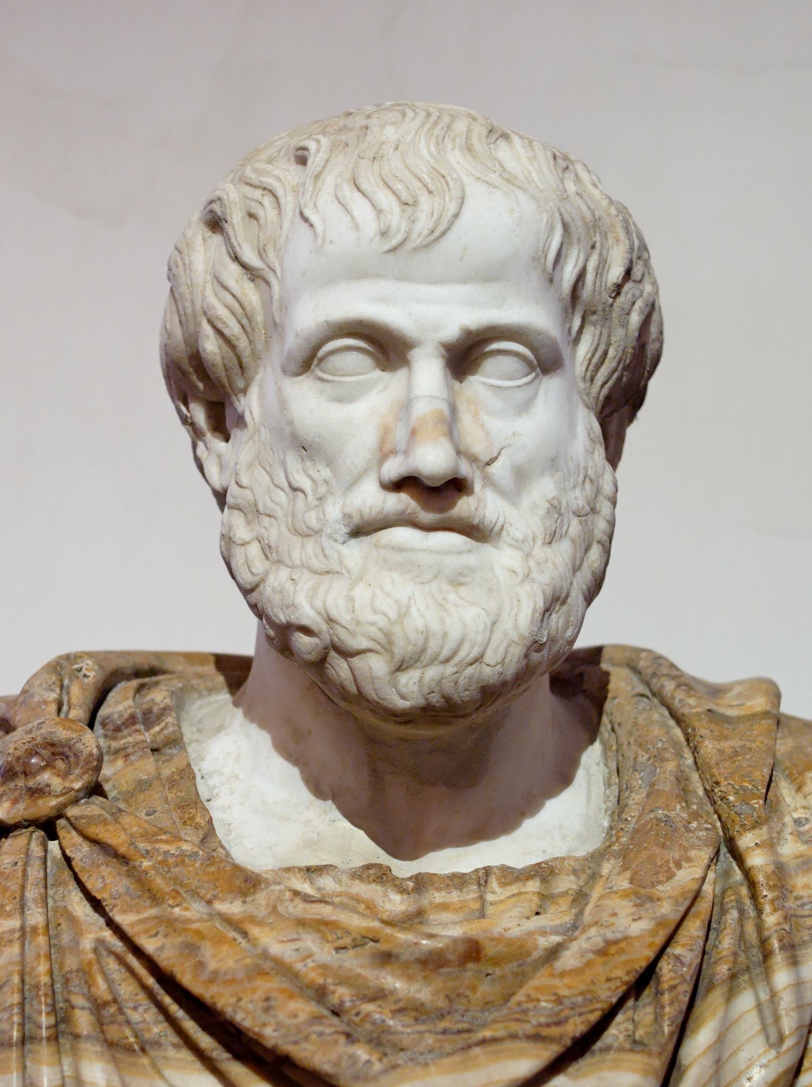

Virtue Theories
According to Aristotle:
Virtues: Good habits which regulate our emotions.
e.g., develop courage to overcome fear.
Difficult to balance
e.g., too much courage encourages rash behaviour / not enough cowardice.
Supplemented by theological virtues (faith, hope and charity)
Aristotle – Bronze bust created by Lysippos (c. 330 BC)

Slide 16
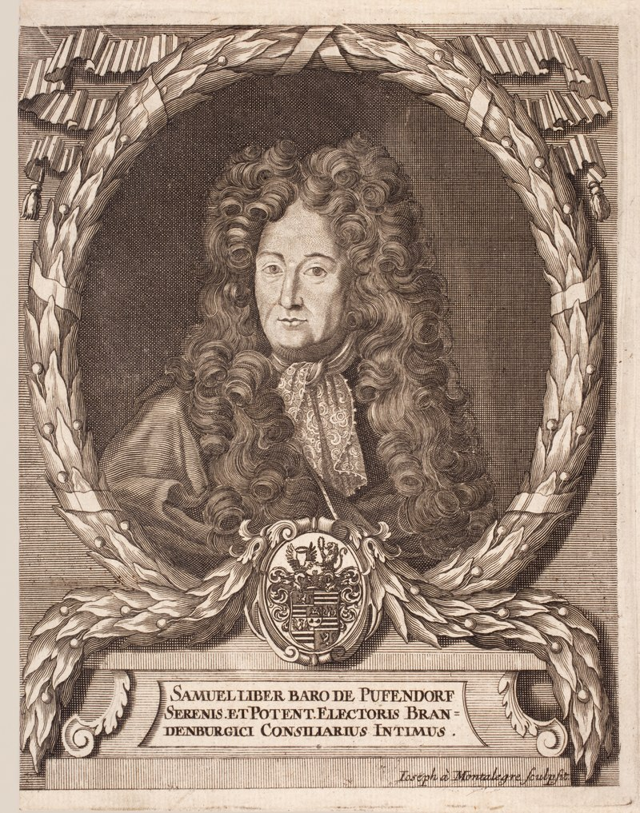
Duty Theories
Image – Engraving of Samuel von Pufendorf by Joseph de Montalegre (1706)
Basing morality on specific foundational principles of obligation.
For example, we have a duty to care for our children, even if there are no financial rewards for doing so.
There are four central Duty Theories:
Pufendorf (17th Century)
Three kinds of duty:
To God:
Theoretical – to know of God
Practical – to inwardly and outwardly worship God
To Oneself
Of the Soul – develop one’s skills and talents
Of the Body- not harming one’s body
To Others
Absolute – avoid wronging others, treat as equals, promote the good of others
Conditional – various types of agreement, principally to honour promises.

Slide 17

Rights Theory
Natural/Moral rights and Legal rights
Natural/Moral rights – The assumed rights that a being is born having.
Legal rights – Those granted to a being, independent of Natural/Moral rights.
A right is a justified claim against another person’s behaviour.
The rights of one person implies the duty of another.
I have a right of payment, the person in debt to me has a duty to pay.
Correlativity of rights and duties.

Slide 18
Rights Theory (cont.)
Locke (17th Century)
Natural rights – not to harm life, health, liberty or possessions
Heavy influence on the US Deceleration of Independence Features of moral rights
Natural
-Not created invented or created by government
Universal
Do not change from country to country
Equal
The same for all people, irrespective or race, gender etc.
Inalienable
Cannot be handed over to another (e.g., slavery)

Slide 19
Rights Theory
Kant (18th Century)
Influenced by Pufendorf and agreed with moral duties but argued for Categorical Imperatives that could be all-encompassing.
Treat people as an end and never the means to an end
As opposed to hypothetical imperatives that may hinge on a personal desire
If you want a good job, you should go to university.
Ross (19th Century)
Disagreed with Kant – Too simplistic.
Proposed a list of Prima Facie duties instead – better reflect actual moral convictions:
Fidelity – The duty to keep promises
Reparation – A duty to compensate others when we harm them
Justice – A duty to recognise merit
Beneficence – A duty to improve the conditions of others
Self-improvement – A duty to improve our virtue and intelligence
Non-maleficence – A duty not to injure others
Recognises that situations exist where we must choose between conflicting duties
E.g., to help a friend bury a body. Justice – is our actual duty
Fidelity – is our prima facie duty

Slide 20
Consequentialist Theories
Depending on the consequences of our actions
Weighing up good and bad potential consequences to inform our moral judgements
Ethical Egoism
The consequences for the agent performing the action
Ethical Altruism
The consequences for others involved
Utilitarianism
Everyone, including the agent, is considered.

Slide 21
Problems:
The Doctor’s Dilemma:
A doctor has six severely ill patients all requiring life-saving treatments.
One patient requires medicine in order to recover. The other five patients require organ transplants.
The doctor has the medicine to cure one patient and ensure their survival. But…
if that patient were to die, their organs could be used to save the other five patients.

Slide 22

These are clearly conflicting
Consider the example:
Investor being chauffeured though a developing country
Witnesses a car accident
Driver refuses to stop
Later explains that the assisting party is often held responsible for causing the accident
Utilitarianism is further divided.

Slide 23
Social Contract Theory
Suggested by Hobbs
Advocates metaethical theory of egotism
i.e., all actions are selfishly motivated
Better off in a world with moral rules than without
Otherwise, our property, families, lives would be at risk to the whims/selfish interests of others.
Adopt rules for our own safety

Slide 24

Applied Ethics
Examines specific controversial issues such as:
Abortion
Capital punishment etc.
Computer Ethics
Ethics of Video Games (as objects)
Ethics of Video Gaming (as an experience)

Slide 25

Computer and Information Ethics
Let’s start with some history (more here)
Early Computer and Information Ethics
Innovative developments in the mid 40's in both science and ethics
Norbert Wiener – MIT Prof. Maths and Engineering
Cybernetics
Ethical implications of electronic computers
Key human values
life, health, happiness, abilities, knowledge, freedom security and opportunities
Concerns covered:
TV Radio, computers, networks, information, media and journalism and even books and libraries

Slide 26
Computer and Information Ethics (cont.)
Wiener believed that in order to 'flourish’:
Maximize their potential as intelligent, decision-making beings
Because of various levels of talent and ability each person achievements will be different.
Engage in creative and flexible actions
This led him to define the "great principles of justice":
See next slide…

Slide 27
Weiner's Great Principles of Justice
Equality of individuals such that what is just for each is the same if their places are exchanged
Good will between man and man with no limits
Existence of community and state must produce no unnecessary infringement on freedom
Freedom of an individual to develop to their maximum potential

Slide 28
Computer Ethics
Walter Maner
1970s pioneer in computer ethics
Taught medical ethics
Course increased in complexity as computers become more common.
Led to a separate course in computer ethics
Early debate:
Are computer ethics a new branch of applied ethics?
or simply a twist on old problems?
1980s first book on computer ethics - Computer Ethics 1985

Slide 29
Manners Approach
Identify a policy vacuum generated by computing technology.
Eliminate any conceptual muddles.
Use the core values and the ethical resources of just consequentialism to:
Revise existing (but inadequate) policies
Create new policies that justly eliminate the vacuum
Note:
The original context was the proliferation of medical information systems?
Can this still be applied?

Slide 30
Computer Ethics (cont.)
Early approaches focused on a "human-values approach"
Focus on fixing problems caused by software/hardware etc.
Value-sensitive Computer Design
Shift towards avoiding problems Late 1990s
Anticipate harm to human values
Design new technology (inc. software) to avoid this.

Slide 31
Computer Ethics (cont.)
Professional Ethics
Starts in the early 1990s, gathers momentum
Gotterbarn and others
The 'profession' should be developed and advance of standards for good practice
Codes of conduct
Computer ethics should be seen as Professional Ethics

Slide 32
Example Codes of Conduct
IEEE/ACM (Institute of Electronic and Electrical
Engineers/ Association for Computing Machinery - big computing societies!) defined standards
Gotterbarn was part of both committees
BCS (UKs Professional Computing Society) defined a standard
Made ethics a condition of course accreditation (why you're studying it).
IGDA (International Game Developers Association)
Very similar to others in the software sector.

Slide 33
Example Codes of Conduct
IEEE/ACM (Institute of Electronic and Electrical
Engineers/ Association for Computing Machinery - big computing societies!) defined standards
Gotterbarn was part of both committees
BCS (UKs Professional Computing Society) defined a standard
Made ethics a condition of course accreditation (why you're studying it).
IGDA (International Game Developers Association)
Very similar to others in the software sector.

Slide 34
Computer Game Ethics
Dual focus:
Video Games as Objects
Video Games as Experiences

Slide 35
Video Games as Experiences
Video Games as Objects
Consider video games as objects
Morality of game:
Production
Marketing/Promotion Monetisation
Consider the playing of an individual game
Morality of actions performed by player though avatar
The player / avatar relationship (player-subject)
The player as a human (self-subject)
Player-subject in the game
Key in this discussion:

Slide 36
Video Games as Objects
Early research focused on games as cultural devices
i.e., looked at their effect on cultural development
F. Provenzo (1991) - Video Kids: Making Sense of Nintendo
Focused on:
Issues of simulated violence and gender representation
Nintendo - market dominant (80s - 90s America).
Children as players (developing as moral beings).
Considers players slaves to the rules imposed by the game (devoid of moral choice).

Slide 37
Video Games as Objects
Negative effects of video games well documented
Addiction
Fisher (1994) - Focus more on Arcade machines
Highlights studies demonstrating addictive behaviour
Financial/health - skipping meals to play games
Education - skipping school to play games
Behavioural - stealing to play games
Noted:
Video games addictive for some children
Concerned about home-gaming

Slide 38
Addiction (cont.)
Rooij et al(2010) - Online gaming
Identified a group of addicted gamers
Link to depression, loneliness, social anxiety and negative self-esteem unproven.
Research community still working out how to classify 'addicted' gamers
Early approaches based on gambling but becoming more sophisticated
This paper contributed to policy on non-substance-based addiction in the Netherlands.

Slide 39
Gender Representation
Dietz (1998) - Effect of games on gender representation explored
Female characters limited
Most are victims (to be saved,) or antagonists (evil witch etc.)
Sex objects
The Femme Fatale – Emerged in cinema in the 1940’s, around the time that women started to join the workforce, and again in the 1980’s around the time of Second Wave Feminism. Reaction to the perceived threat of Feminism? Malkowski (2017).
Ludic Femme Fatale is more recent.
Max Payne 2 – Mona Sax: Strong neo femme fatale or male protagonist re-skin?
Children are still learning about gender roles (social learning).

Slide 40
Accessibility
A recent survey (Yan et al 2011) suggests an increased interest in accessibility in games
Accessibility problems may include not being able to:
Receive feedback
Determine in-game responses
Provide input using conventional input devices.
Key issues Porter and Kientz (2013):
Incompatability with assistive technologies (on-screen keyboards/custom controllers)
Results also suggest more PC/Linux/Mac gamers than console.
No audio description

Slide 41
Accessibility (cont.)
Porter and Kientz (2013) also investigated how these are considered by industry
Focused on 'low hanging fruit'
Focus on simple features - e.g., colour blind friendly pallets.
Straight forward fixes - e.g., text on screen for hearing impairments
Developer diversity
Increasing diversity leading to more experience with some accessibility issues
Education / Awareness vs conceptual grasp of implications

Slide 42
Accessibility (cont.)
Porter and Kientz (2013)'s industry preconceptions continued:
Pressure to adhere to standards
Needs to come from high up in the organisation (targets for outreach).
Role of middlewear
Some features best implemented in game engines
E.g., Text-to-speech/descriptive audio - game elements are easily tagged but adding the audio would be at a lower level.
Role of OS
Drivers for assistive technology readily available for PC/Mac/Linux
Console level drivers tightly controlled.
Change anticipated as console 'move into the living room'.

Slide 43
Gambling
On Games
Recent research ((Holden et al, 2017)) suggests:
Debate over esport as a sport
Rise in problems associated with traditional sports
Internal threats:
Performance-enhancing drugs
Match-fixing
External threats:
Regulated / Unregulated Gambling
Protection is minimal and participants potentially young

Slide 44
In Games
Examples include:
Skin Gambling - Counter Strike: Global Offensive (see (Holden et al, 2017))
Skins from pickups (purchase keys).
Gamble on outcome of professional games
OPSkins - handles financial transactions related to skin transfer.
Valve - sued for facilitating illegal gambling

Slide 45
Video Games vs ‘Real’ Games
Some of the issues above clearly relate to 'real' games
e.g., Traditional sports, children's games, card game etc.
However, computer games are:
Designed experiences in a virtual environment
Have rules and properties that (usually,) can't be adapted or corrected.
Can change rules when playing a real game
e.g., Head-height rule in five-a-side football / Touch Rugby
Not possible in video games (or professional sports)
Most real games are not simulations (exceptions e.g., Monopoly)
Most video games present simulated environments (exceptions e.g., poker etc.)

Slide 46
Summary
Ethics is a big subject!
Need to be aware:
New technology - unforeseen issues e.g.
Games: Addiction
Facebook: Depression
IEEE/ACM/IDGA
Professional developers need to think ahead
Is this possible?

Slide 47
Summary (cont.)
Issues of ethics around games:
Gambling
Accessibility
Addiction
Gender Representation
Next week:
Ethics of the game play experience

